Slide 1

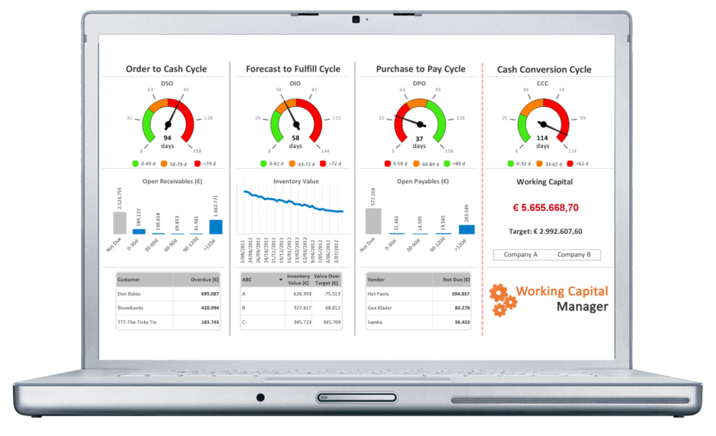
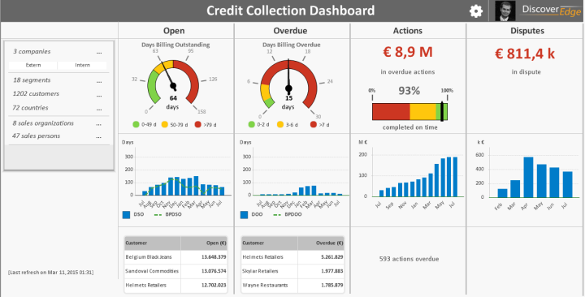
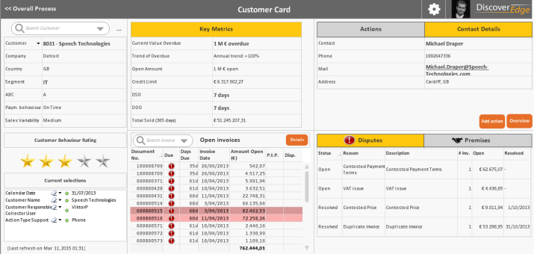
Payment Behaviour
& Collection Technique

Slide 2




About Us
Our history
Founded in 2012
Team of Working capital & IT specialists
Offices in US (New York) & Europe (Belgium)
Our customers are large to mid-size global enterprises
Backed by academic & professional financial advisors
Users in over 20 countries
Mentioned by
Partners

Slide 3
Customer Payment Behaviours
Can pay and will pay
Can pay, but makes you work for payment
Cannot pay

Slide 4
Traditional Customer Segmentation
Accounts are assigned into a segments:
Revenue or Debt Pareto identifies customers that generate 80%, 15% and 5% of revenue
Payment history calculates the account’s weighted average Days to Cash (number of days between the moment an invoice is issued and collection)
Customers behaviour is used as the basis to drive internal collections activities and the associated value of the account drives the level of the relationships
A1 | A2 | A3
B1 | B2 | B3
C1 | C2 | C3
High
Value
Low
Value
Labour intensive and prone to error
Good
Payer
Bad
Payer

Slide 5
Typical collection software delivers some of the following requirements
Analytics for Credit Managers & Sales Managers
DSO, Revenue analysis (per customer, per segment, per entity)
Payment behaviour
Credit Note/Invoice analysis
Dispute analysis
Dunning
Automated emailing using tailored templates
Calling
Promise-to-pay follow-up
Collection/Collector performance analysis
Environment
Multi-user environment for different roles
Efficient dunning workflows based on dynamic payment behaviour segmentation or on user-defined segmentation
Automated call planning
Multi-entity, multi-currency, multi-ERP
CashForce delivers all this functionality

Slide 6
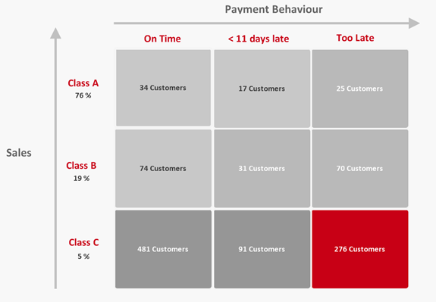
CashForce Segments Automatically
Segmentation becomes quick and accurate
Variables can be easily adjusted
Segmentation then becomes the driver of the right collection activity with the right customer

Slide 7
CashForce Benefits
Qualitative
Structured workflow & follow-up (payment terms, payment behaviour, disputes,…)
More time for productive work
Increased visibility on the open balances for all BU’s & project managers
Ad-hoc transparency for management & board in open balances & disputes
More professional approach & interaction with your customers
Increased accuracy in cash forecasting
Quantitative
Decrease in DSO
Raise in cash balances by improved cash-in
Lower cost of operations

Slide 8

Difference with competition
Automated link with any ERP
Quick implementation time
Continuously evolving platform built on a leading Big Data technology
Not an endless list of never-used features, but best-practice technology development
BEST PRACTICE AWARD
in 2014

Slide 9

CREDIT COLLECTION SCREENSHOTS

Slide 10


Slide 11
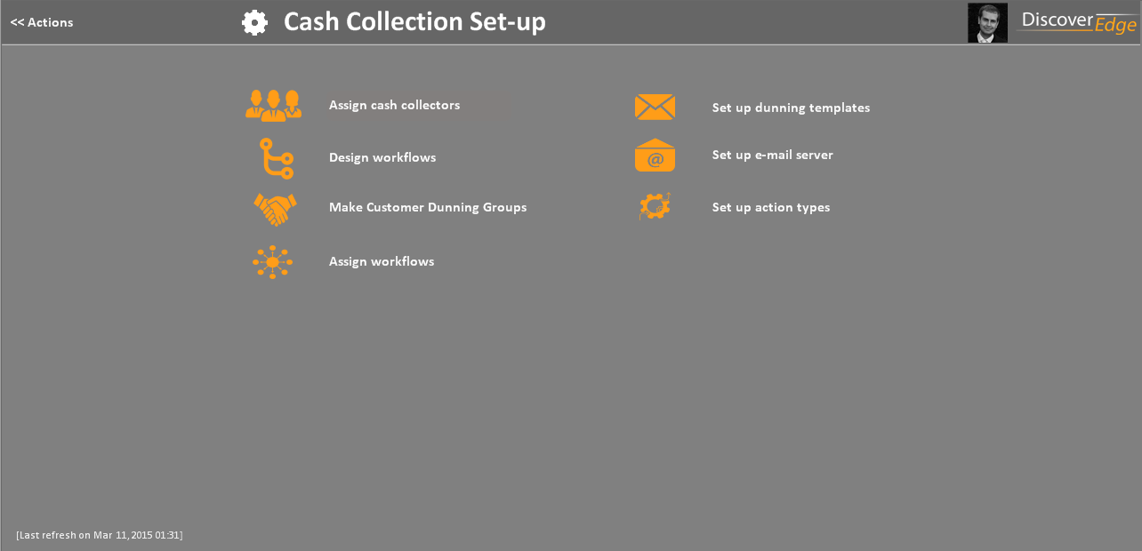

Slide 12
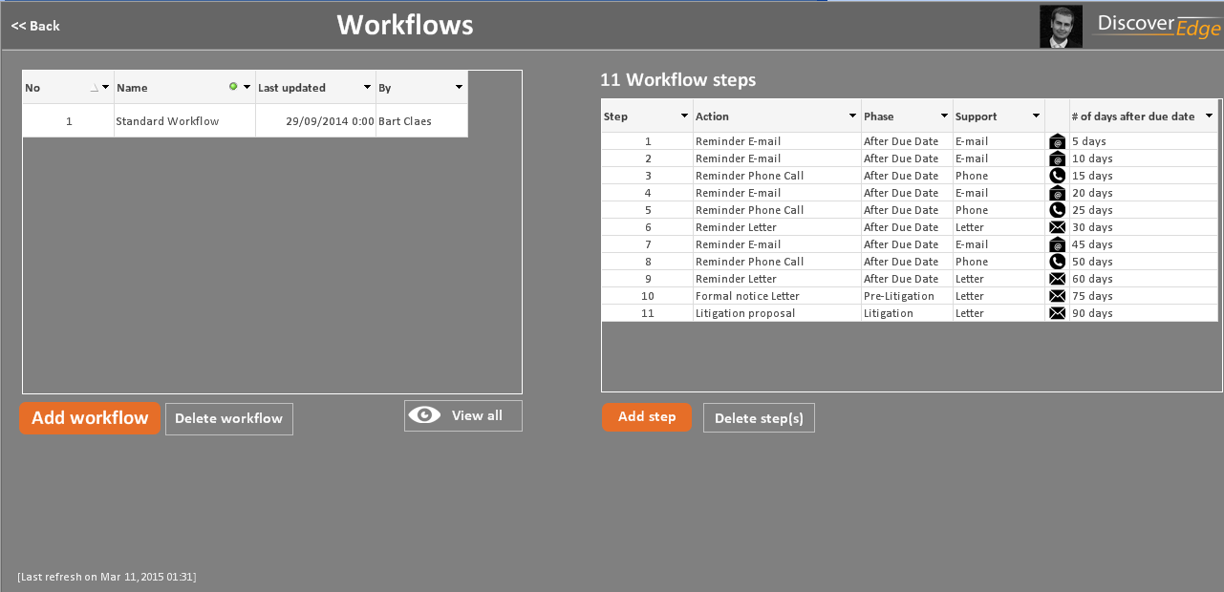

Slide 13
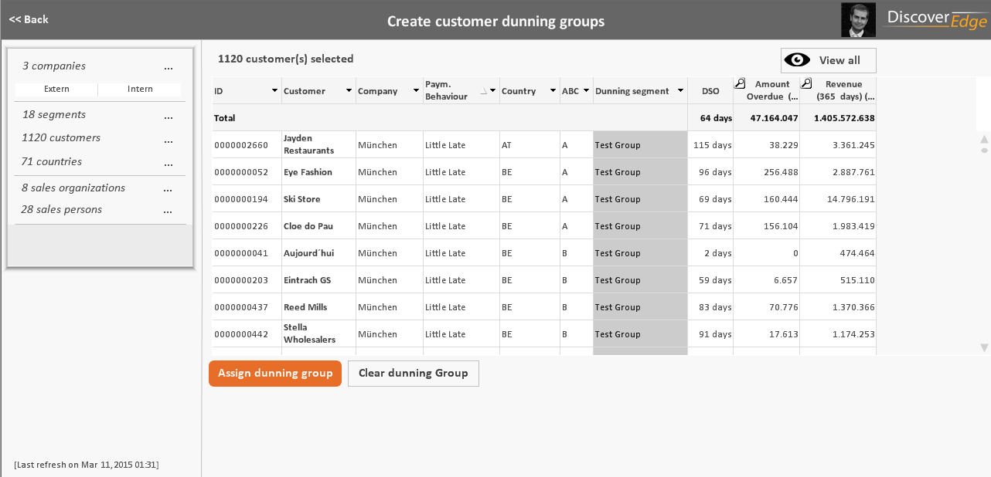
Make use of powerful segmentation options
Create dunning groups for « intensive care »
vs. « low maintenance » customers and assign
a specific collection strategy

Slide 14
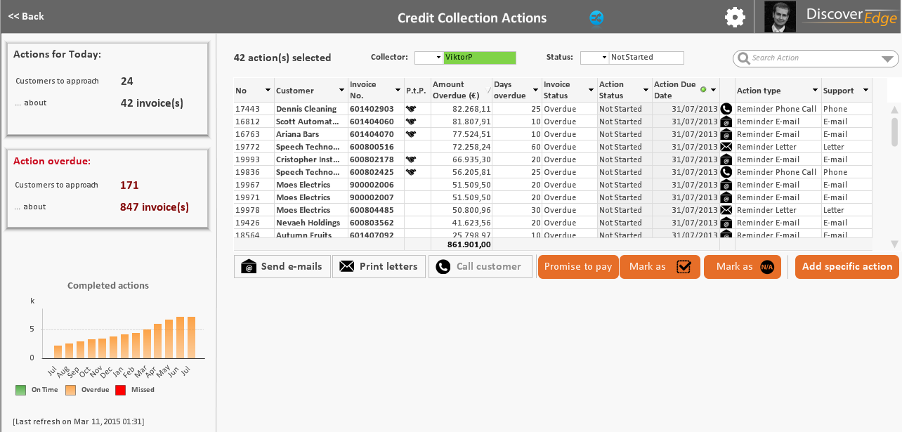

Slide 15
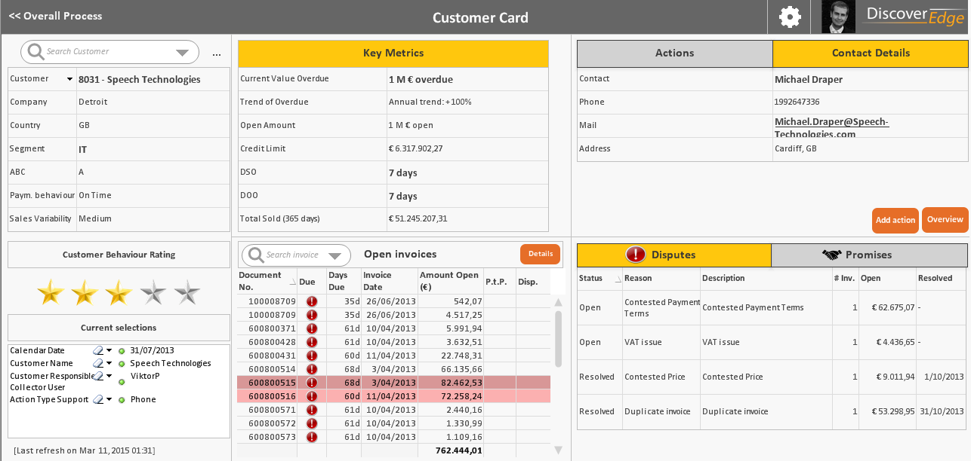

Slide 16
ORDER-TO-CASH Analyses

Slide 17
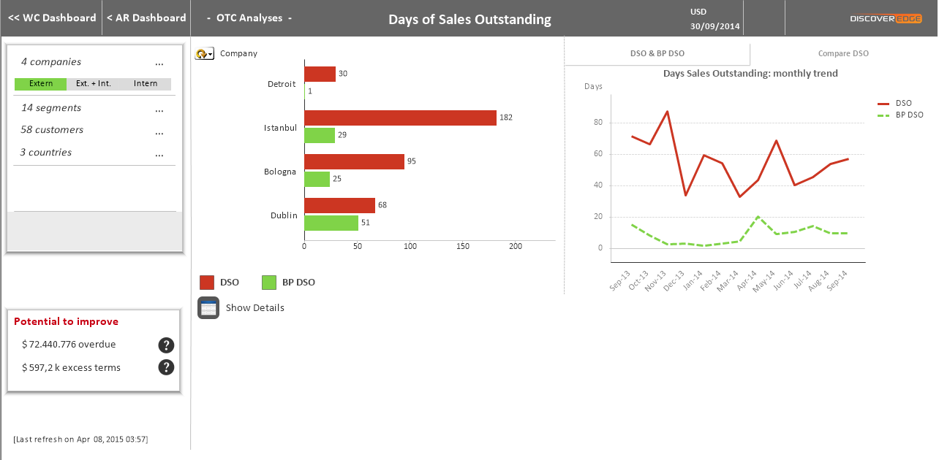

Slide 18
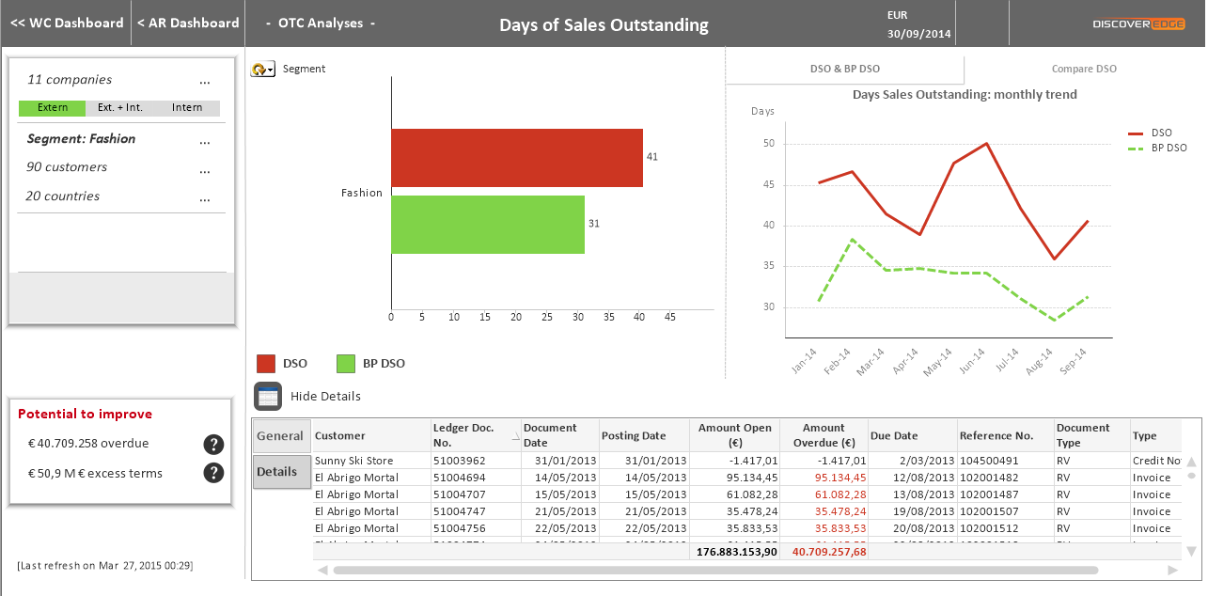

Slide 19
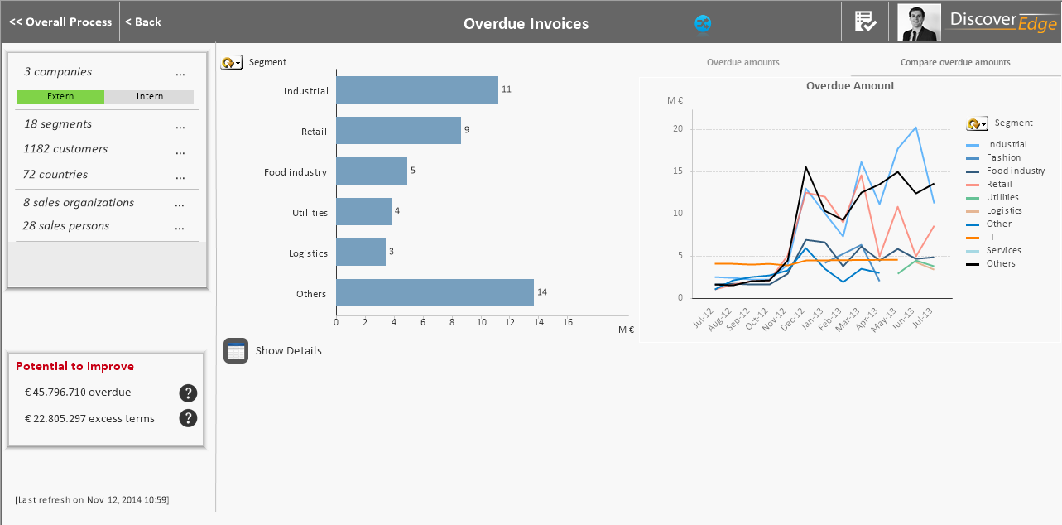

Slide 20
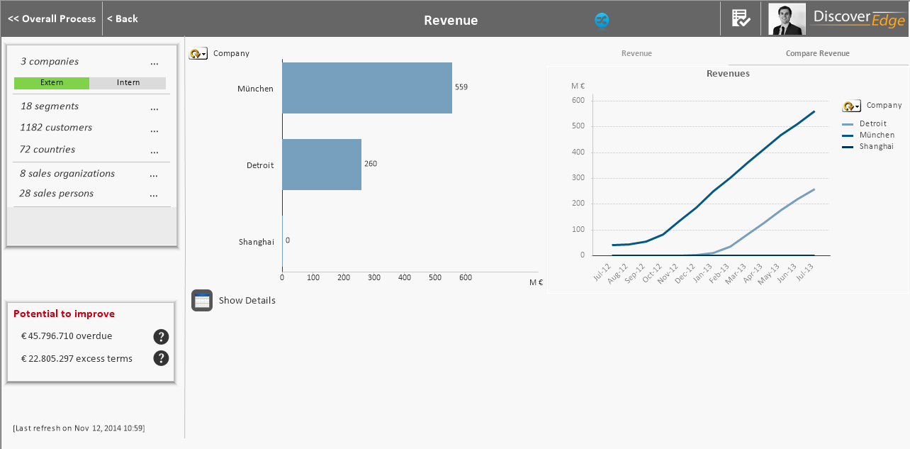

Slide 21
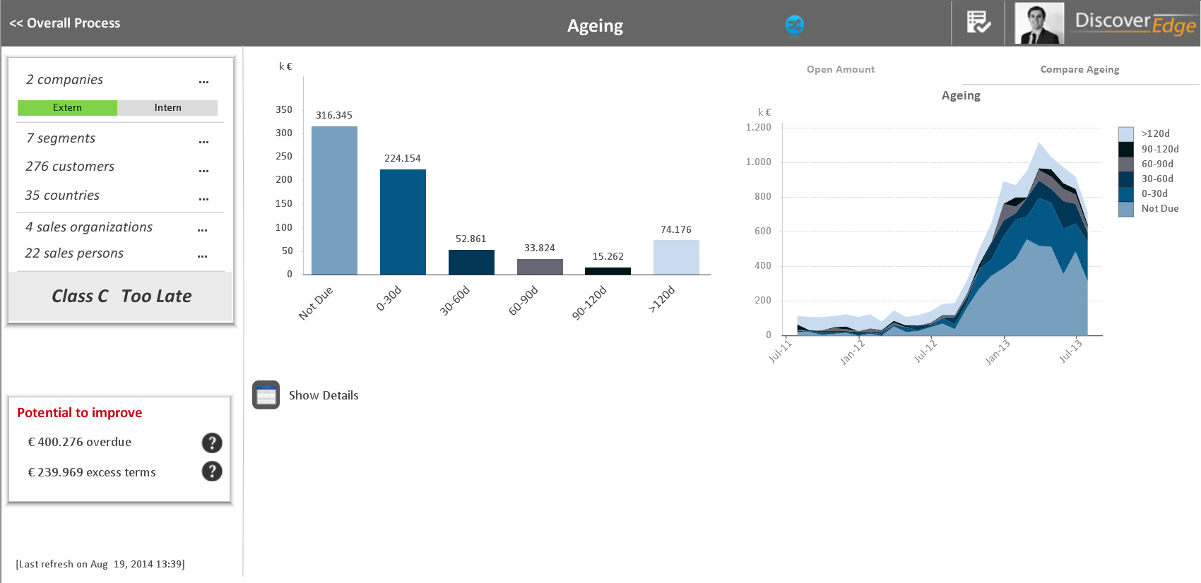

Slide 22
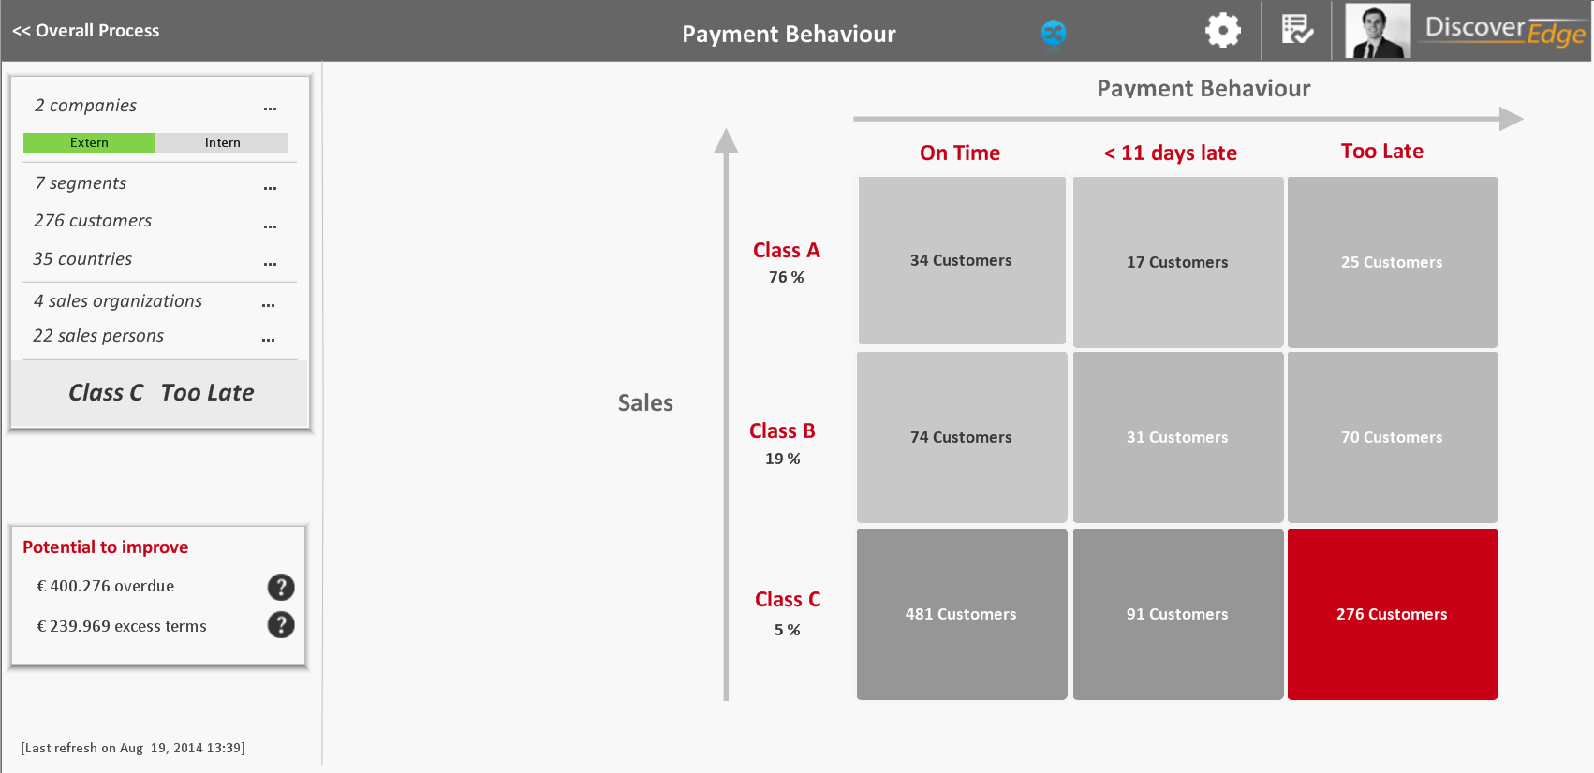

Slide 23
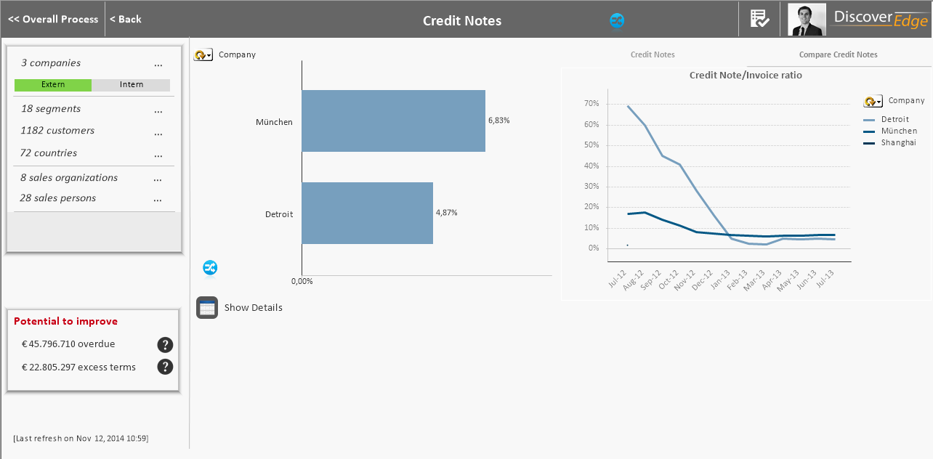

Slide 24
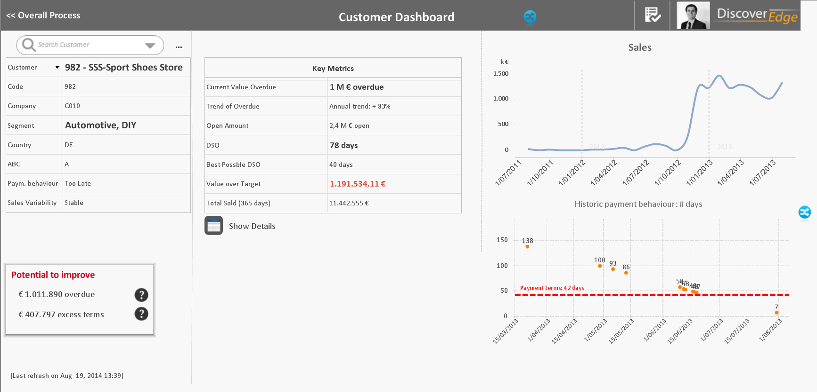

Slide 25
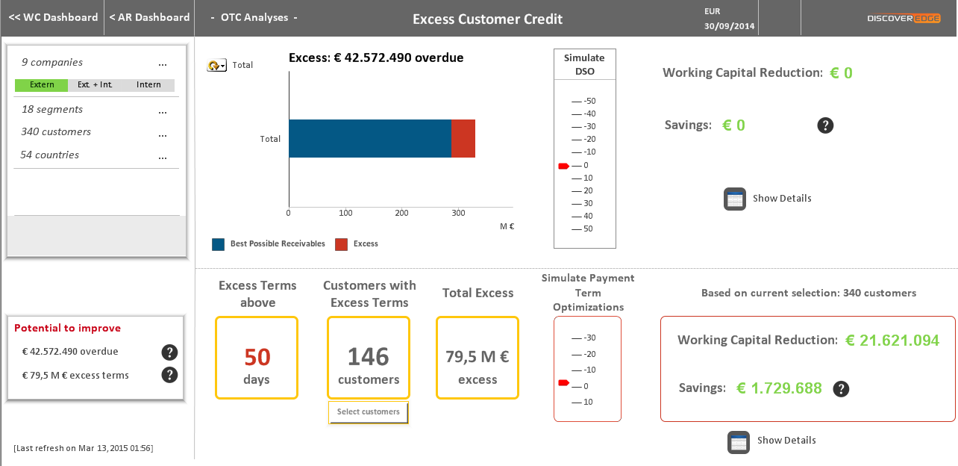

Slide 26
Thank You
Europe
Franklin Rooseveltlaan 348 Ghent, Belgium
Phone: +32 9 336 40 64
USA
1177 Avenue of the Americas, 7th Floor, New York, NY 10036, USA
Phone: +1 (646) 918-1330
Email: info@cashforce.com

