Slide 1


Slide 2

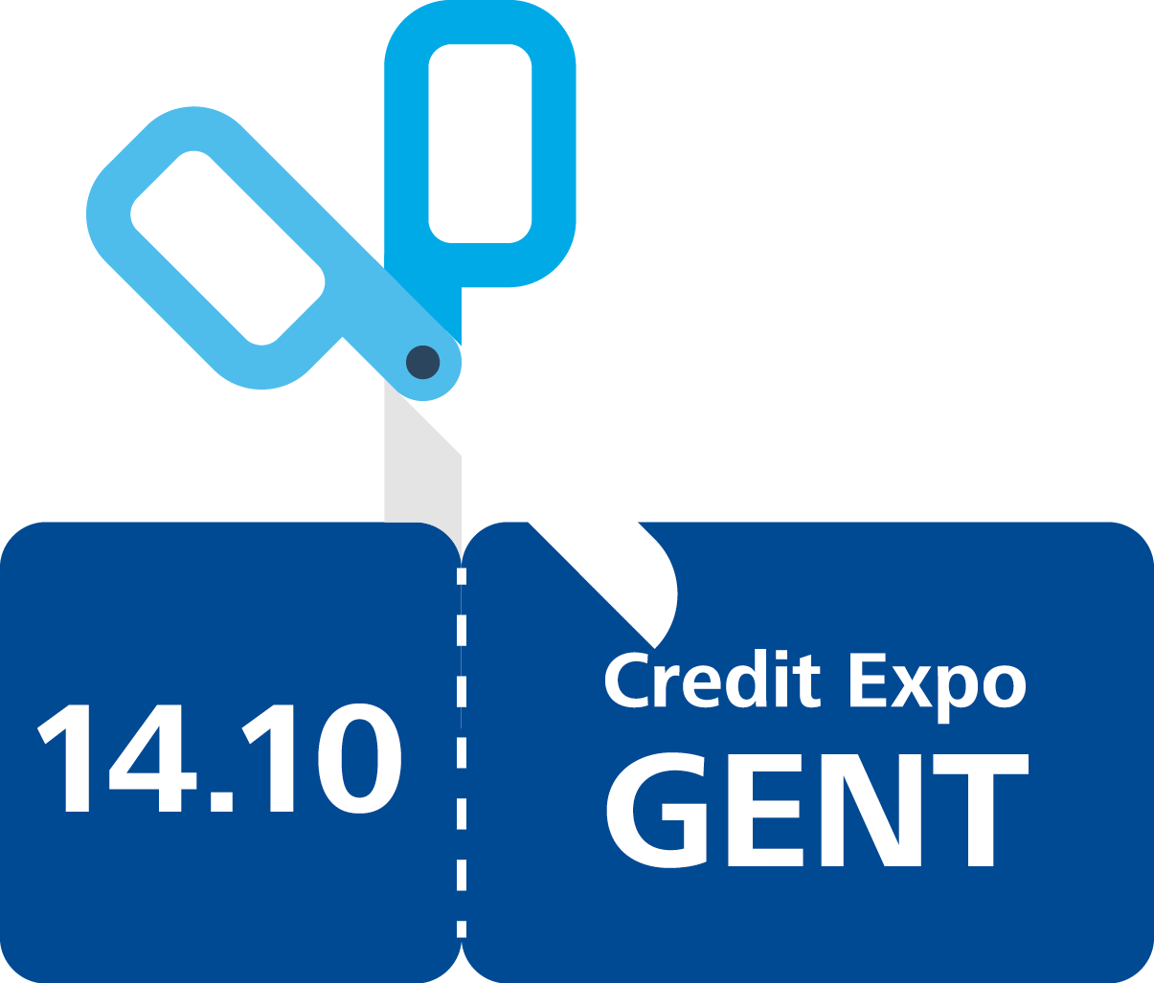
Credit Management Services
Order To Cash
Great Untapped Potential
Bastian De Preter - Manager
Sabrina Valotto – Senior Consultant

Slide 3

Our Expertise
Our vision is to be the standard of excellence, providing consistently superior services that differentiate us in the marketplace.
We deliver multidisciplinary services to respond to the individual needs of our clients.
Accountancy
Accountancy
Audit & Enterprise Risk Services
Audit & Enterprise Risk Services
Tax & Legal
Services
Tax & Legal
Services
Financial Advisory Services
Financial Advisory Services
Consulting
Consulting

Slide 4
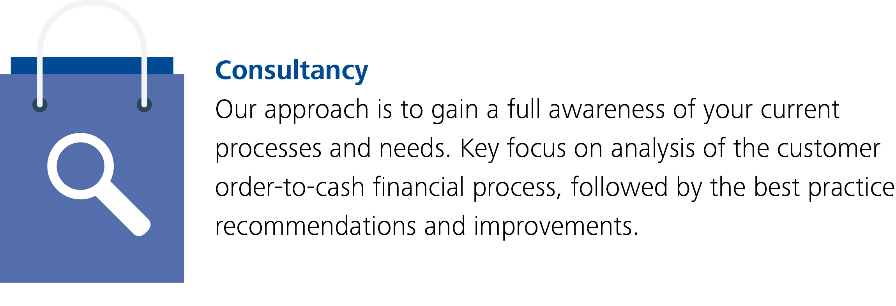
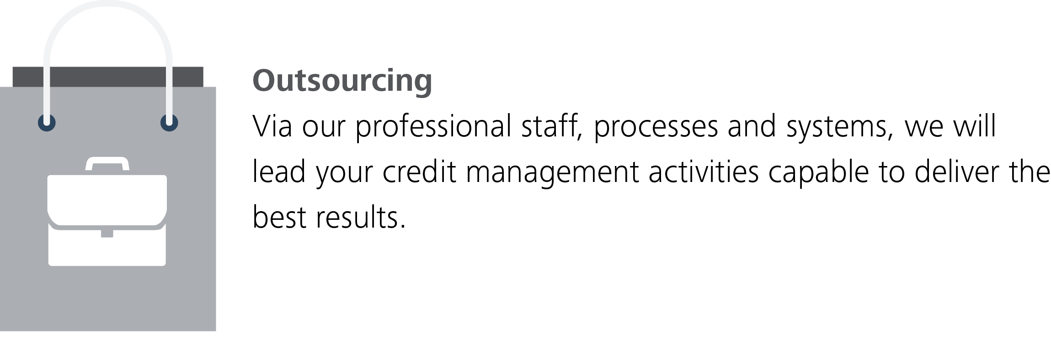
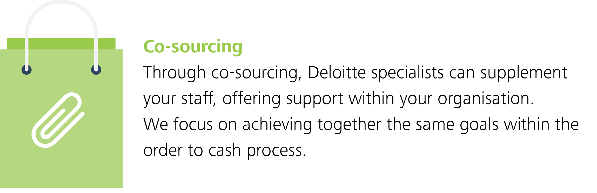
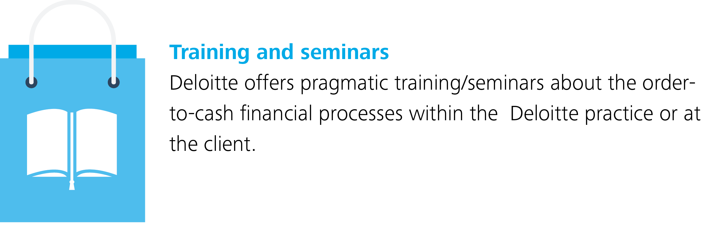
Services supporting the Order-To-Cash process

Slide 5
Contents
  Introduction
  Order To Cash statistics
  Fast track to Order to Cash Improvement
  Automating administrative tasks
  E-invoicing
  Automated accounts receivables
  Credit Policy
  Automated dispute management
  The right tools for faster Order to Cash

Slide 6
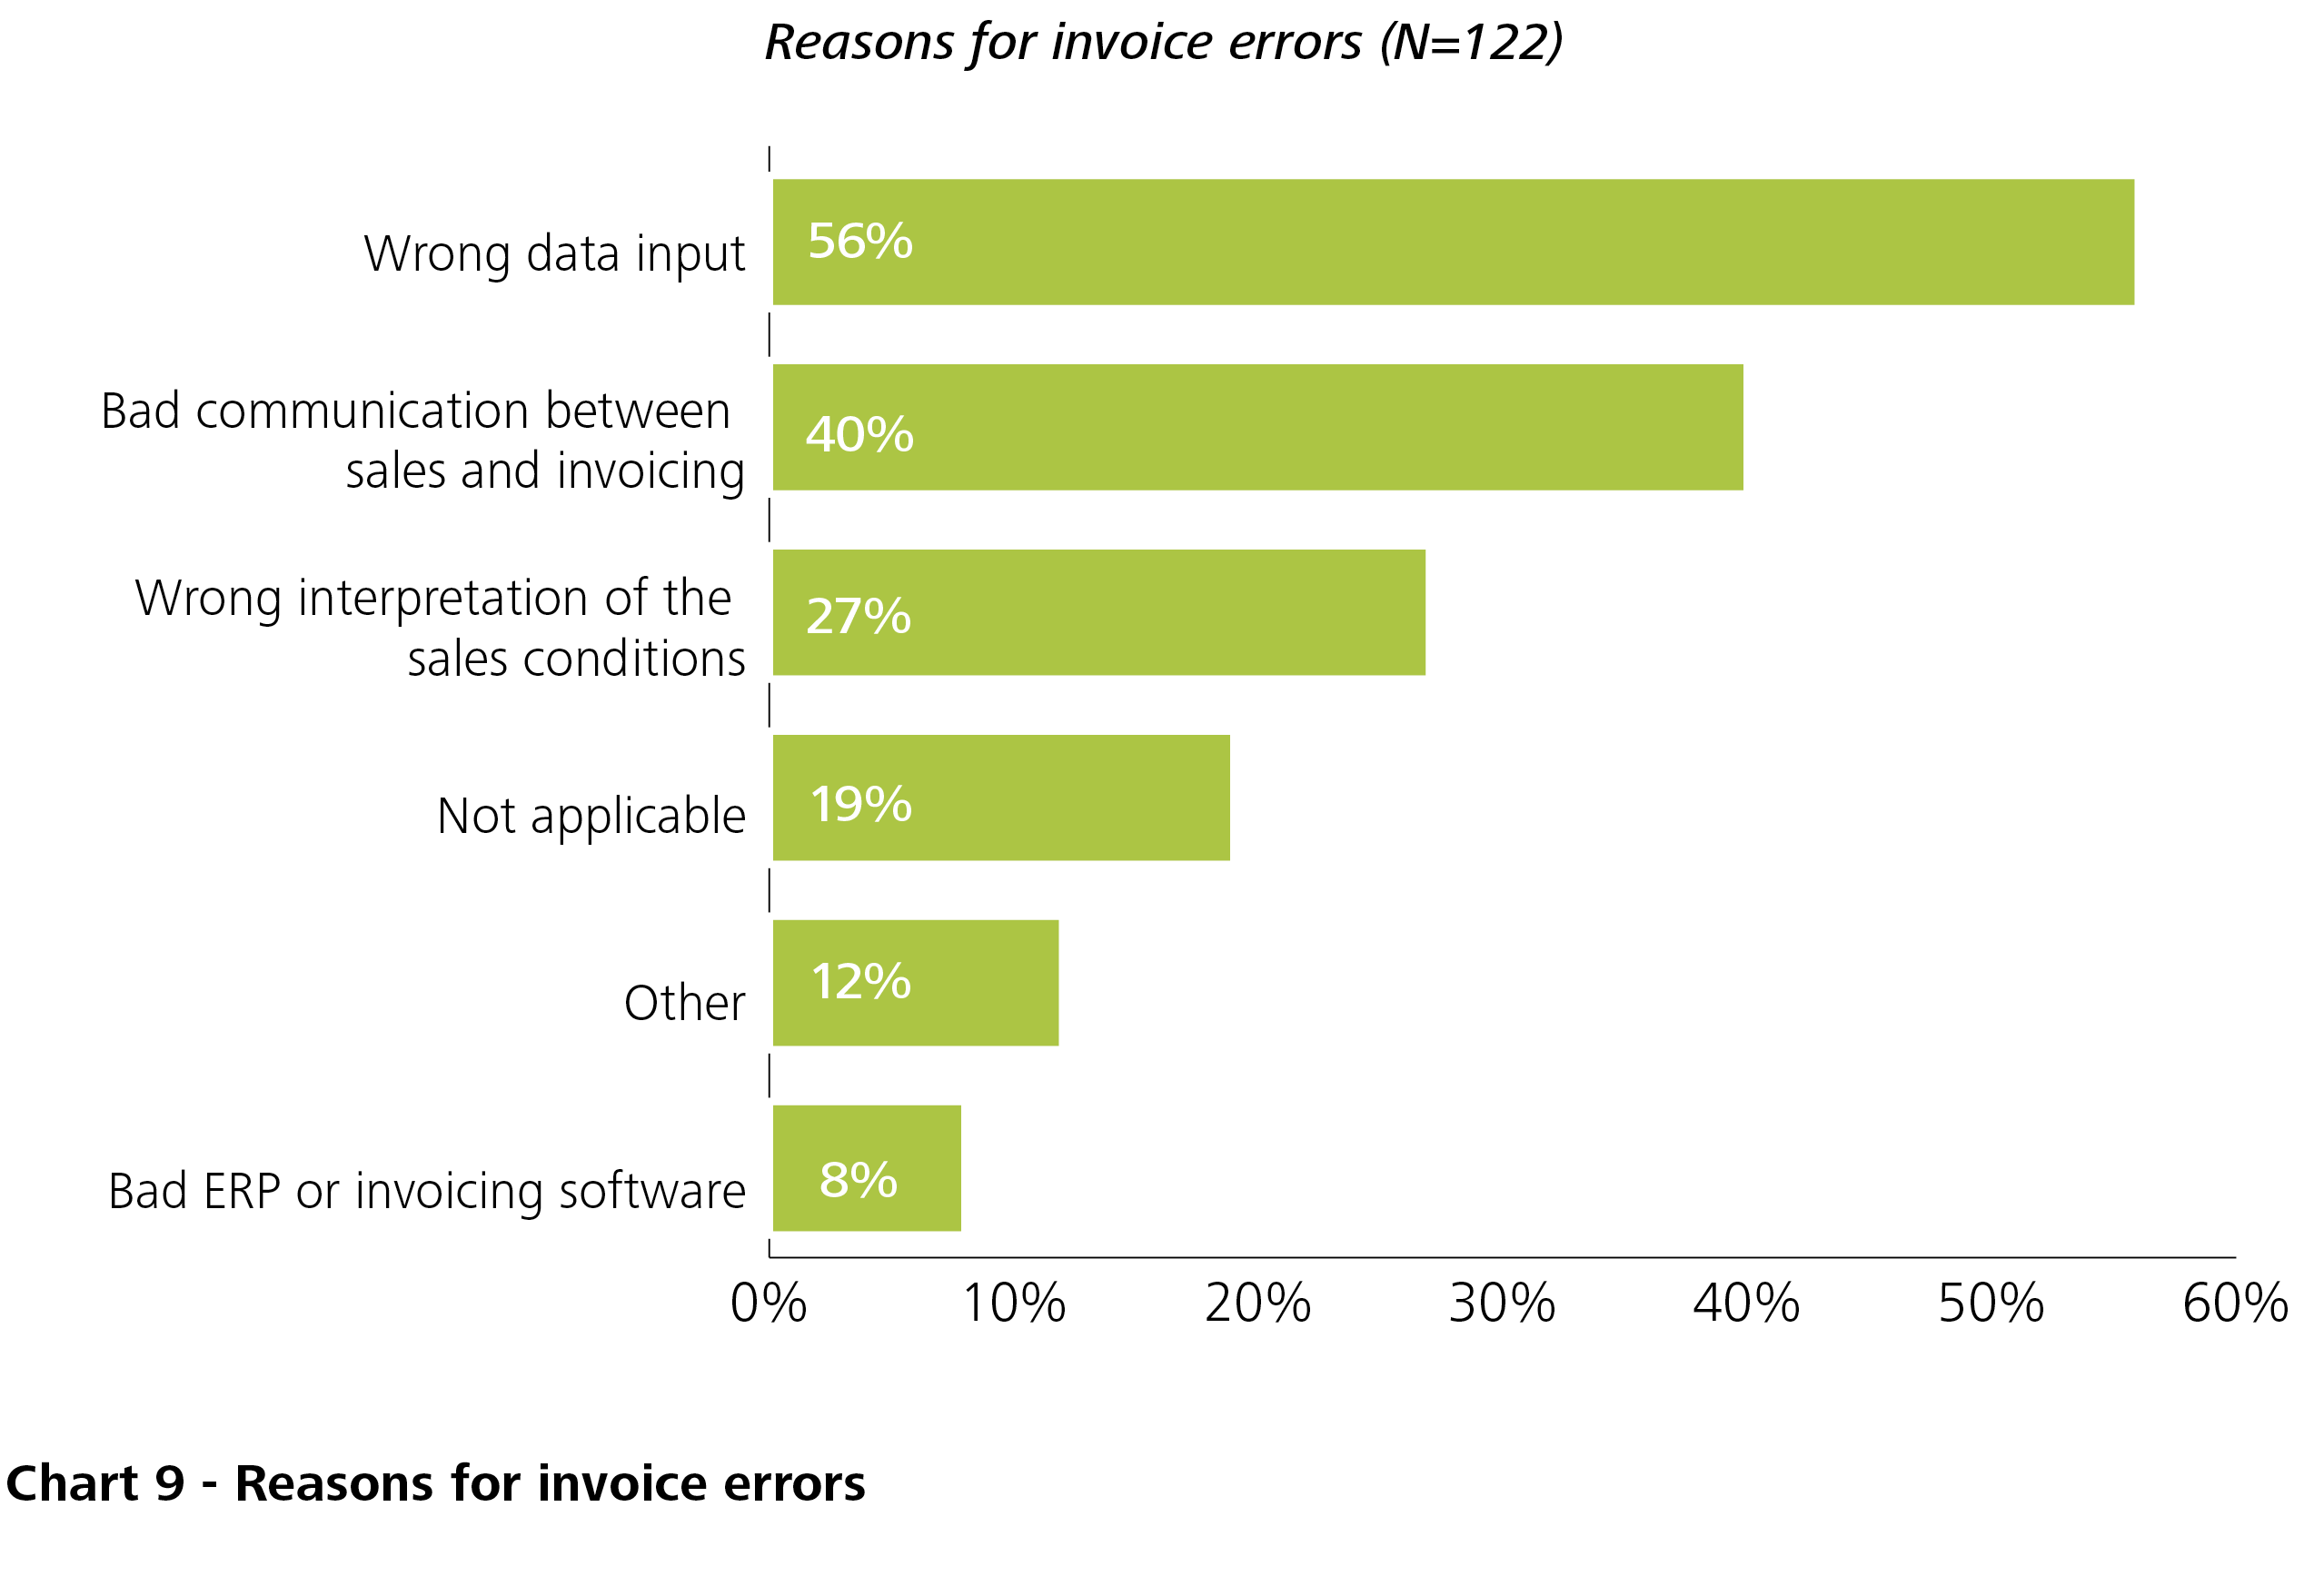
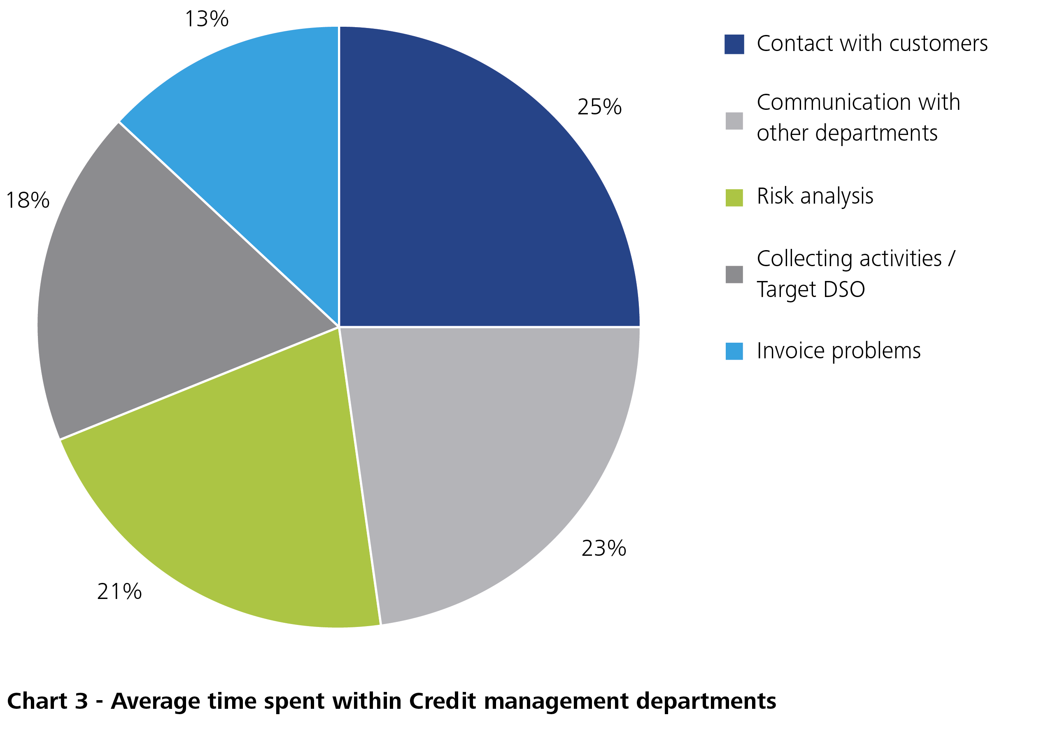
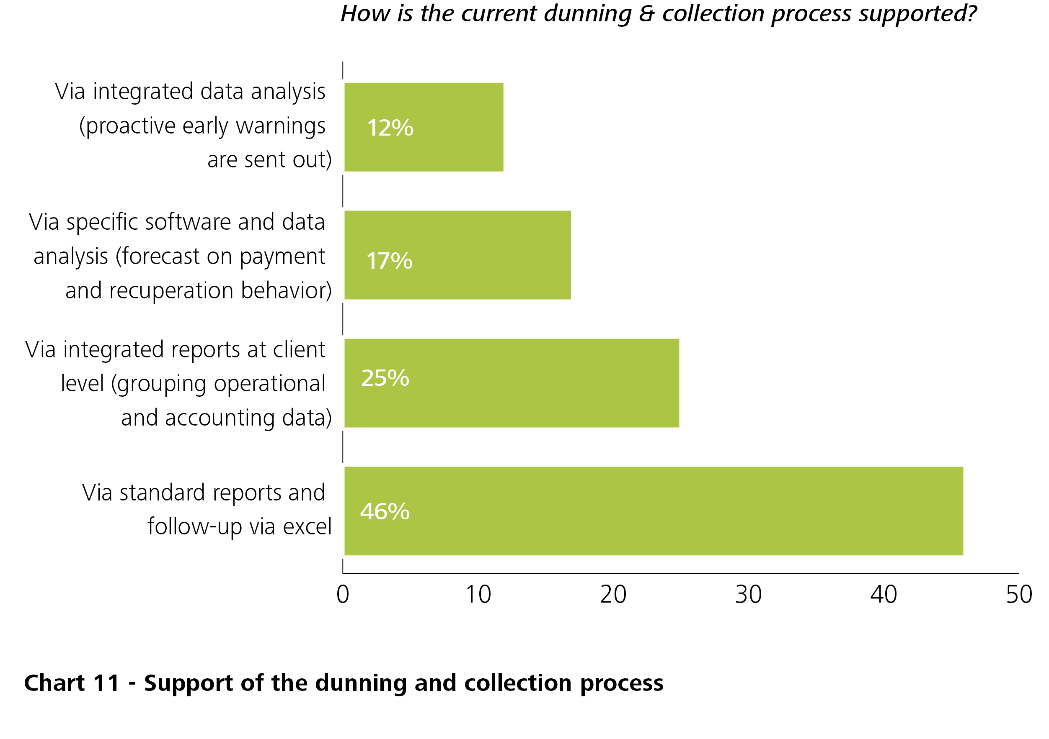
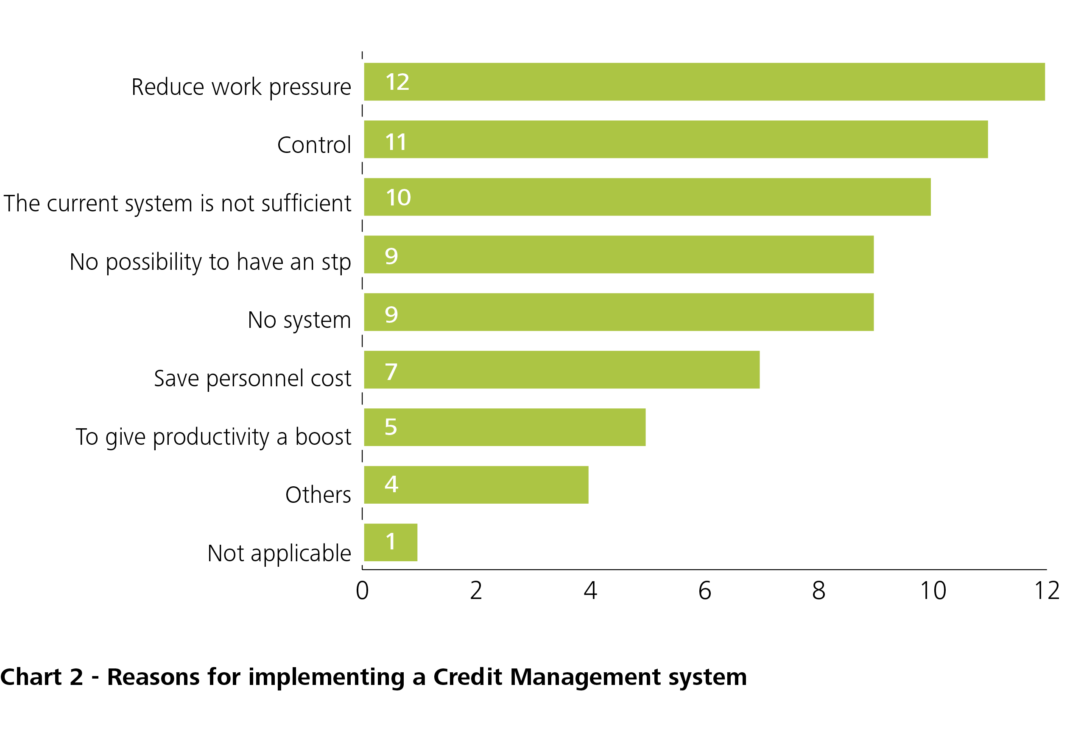
Order To Cash statistics
Notes:
I was also interested to know how much time is actually spent on the different CM activities.
Clear number one is everything relates to communication : both with the client and within the company self,
Other important activities are risk analysis representing 21% and of course collecting activities with the ultimate goal to decrease DSO with 18%.
Last but not least we see that invoice problems cover 13%. I will come back to this later in the presentation

Slide 7
Fast track to Order To Cash improvement
Automating administrative tasks
Helps streamline your processes and remove non-value added steps
Sending Electronic invoices
Automated Accounts Receivables
E-invoicing
Speeds up the process leading to lower DSO & customer satisfaction
Re-evaluating Credit Policies
Automated Accounts Receivables
Allows for centralized AR information eliminating time consuming tasks
Automating administrative tasks
Automated Dispute Management
Credit Policy
Designed to optimize your resources, reduce credit risk, and improve overall cash flow
Automated Dispute Management
Allows for faster dispute resolution, leading to better customer satisfaction
WORKING CAPITAL

Slide 8
Automating administrative tasks
  Helps streamline your processes and remove non-value added steps
  Quality: Repetitive tasks are prone to error
  Frees up your workforce
  Speed

Slide 9
E-invoicing
  Cost Savings
  Shorten Days Until Payment
  links the internal processes of enterprises to the payment systems
  Single Euro Payment Area (SEPA) offers an ideal launching pad

Slide 10
Automated Accounts Receivables
  Consistent processing rules
  Flexible, automated task routing
  Ready access to information for reporting and analysis
  Visibility of transaction status

Slide 11
Credit Policy
  Maintain good cash flow
  Reduce risk of bad debt
  Team approach – Liaise with sales operations
  Profitable and healthy customer portfolio

Slide 12
Automated Dispute Management
  Speeds up dispute resolution and collections
  Advanced workflows
  Identify recurring issues
  Provides queue prioritization
  Higher customer satisfaction

Slide 13
The right tools for Order To Cash
Looking to speed up the OTC process? Here are two must-haves!
ERP SYSTEM
Standard Procedures
Quoting & Order Management
Manufacturing & Logistics Management
Measuring of KPIs
Electronic document Management
Up-to-date & centralized data
…
OTC SOFTWARE
Account & Contact Management
Actions & Communication Management
E-mail archiving
Advanced insights & Reporting
Credit Management automation
Global Credit & Collection capabilities
Order/Shipment blocks
Dispute Management
…

Slide 14

Conclusion: Order To Cash
transaction is getting tied up somewhere along the order to cash cycle
identify red flags in your business
WORKING CAPITAL
what you can do to rid yourself of these inefficiencies
Must-have for a successful business

Slide 15

Questions?

Slide 16
THANK YOU
Deloitte refers to one or more of Deloitte Touche Tohmatsu Limited, a UK private company limited by guarantee (“DTTL”), its network of member firms, and their related entities. DTTL and each of its member firms are legally separate and independent entities. DTTL (also referred to as “Deloitte Global”) does not provide services to clients. Please see www.deloitte.com/about for a more detailed description of DTTL and its member firms.
Deloitte provides audit, tax, consulting, and financial advisory services to public and private clients spanning multiple industries. With a globally connected network of member firms in more than 150 countries and territories, Deloitte brings world-class capabilities and high-quality service to clients, delivering the insights they need to address their most complex business challenges. Deloitte’s more than 200,000 professionals are committed to becoming the standard of excellence.
This communication contains general information only, and none of Deloitte Touche Tohmatsu Limited, its member firms, or their related entities (collectively, the “Deloitte Network”) is, by means of this communication, rendering professional advice or services. No entity in the Deloitte network shall be responsible for any loss whatsoever sustained by any person who relies on this communication.
© 2014. For information, contact Deloitte Belgium

